Slide 1
GRADUATING SEMINAR
RESEARCH QUESTION
Emma Leach T00683129
Winter 2026

Slide 2
“How does study abroad students’ consumer behaviour in tourism change from pre-departure to during study abroad?”

Slide 3
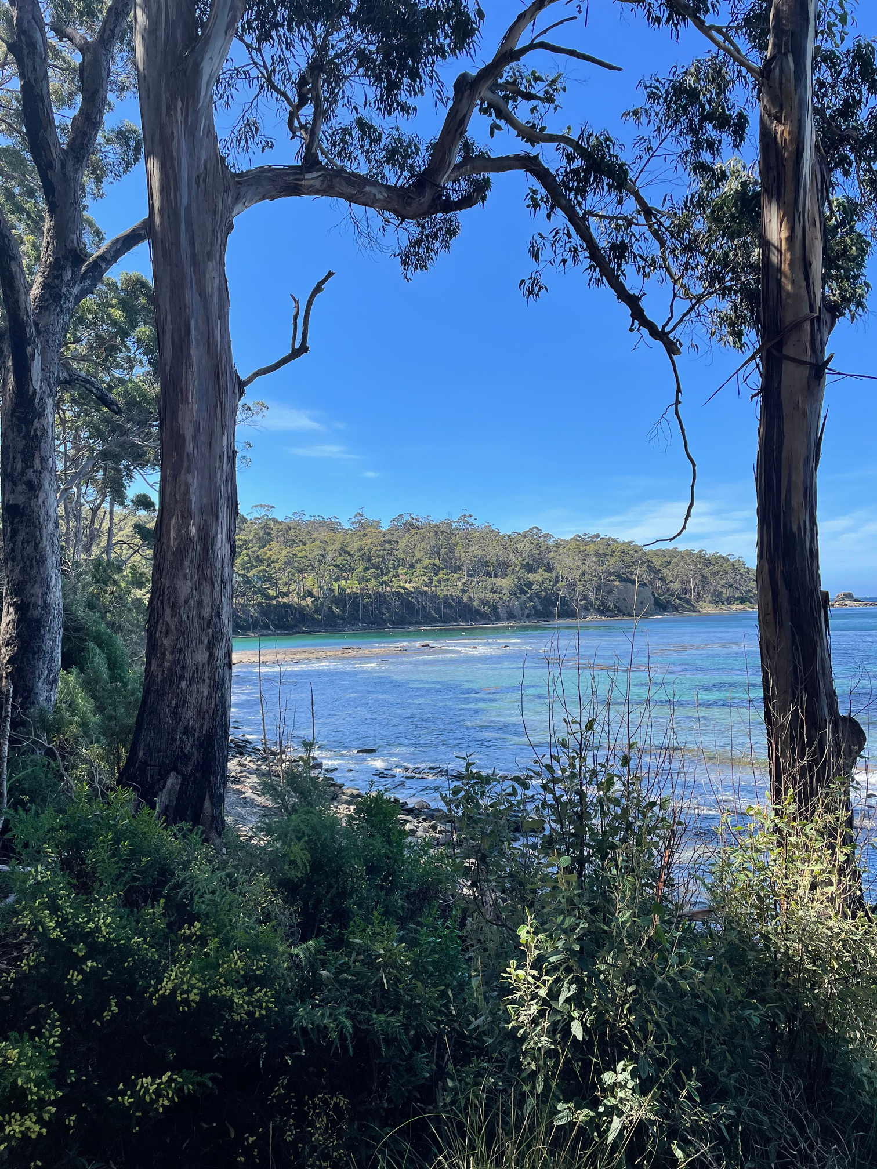
Initial Insights from Literature
  Students engage in tourism alongside academics
  Expectations are formed before departure
  Behaviour often changes once students are immersed
This suggests tourism-related consumer behaviour evolves through experience

Slide 4
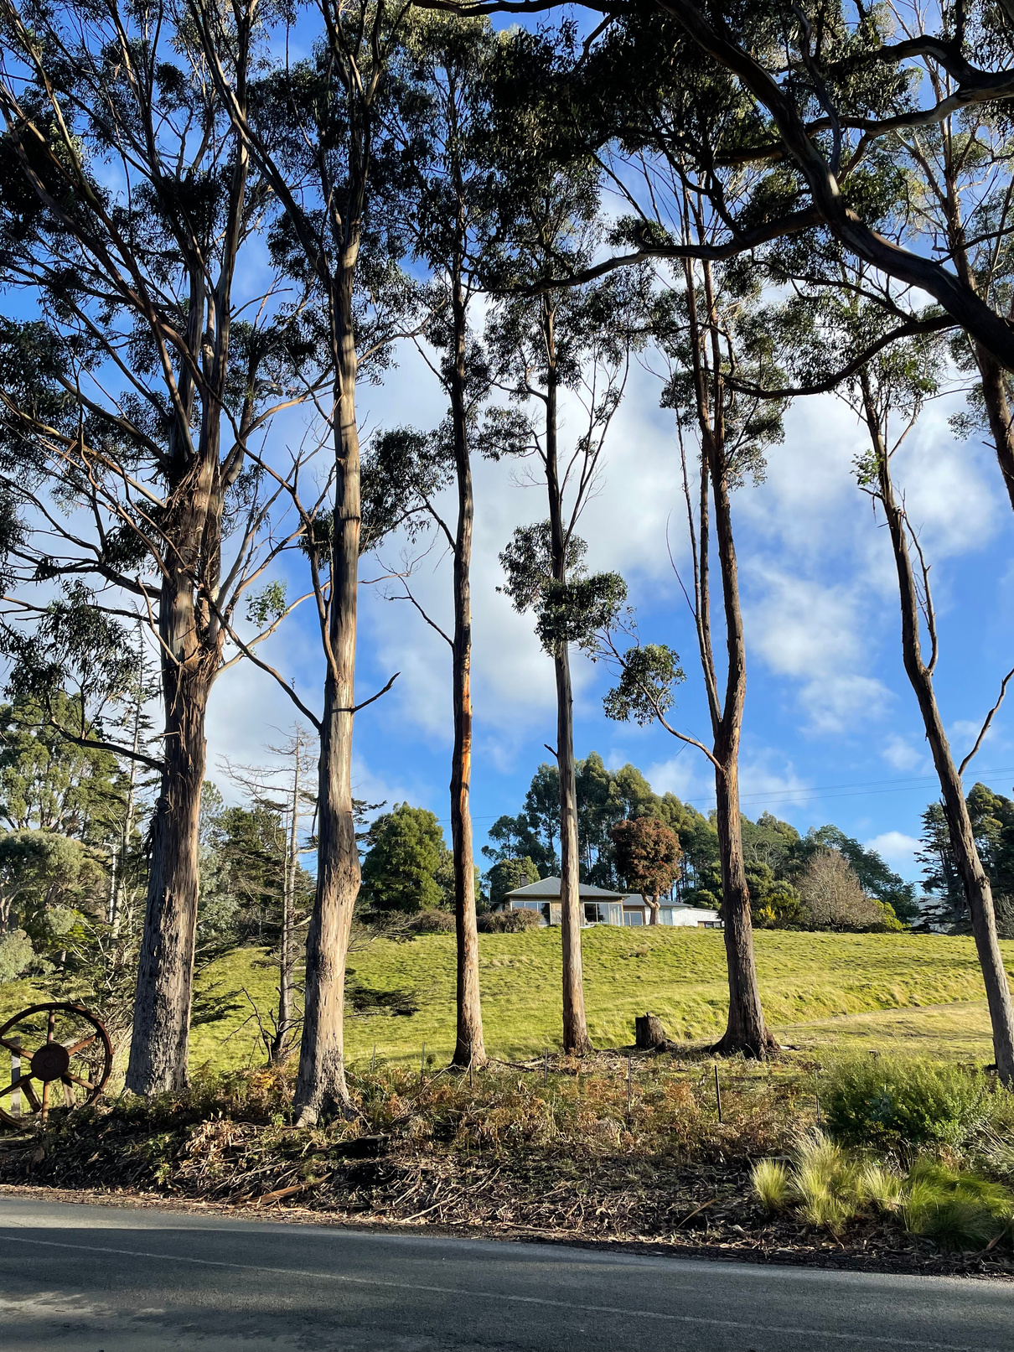
Theoretical Framework
CONSUMER DECISION-MAKING PROCESS (CDM)
  viewed as a process, not a single action
  Decisions unfold across multiple stages
  Behaviour is shaped by information, context, and lived experience
  CDM allows examination of change over time

Slide 5
Consumer Decision -Making
Stages
Need Recognition
Information Search
Alternative Evaluation
Purchase
Post-Purchase Behaviour

Slide 6
CDM & Research
  Pre-departure behaviour aligns with early CDM stages
  Behaviours during study abroad reflects post-purchase behaviour
  Lived experience reshapes tourism-related decisions
  CDM explains when and how consumer behaviour changes

Slide 7
QUESTIONS?

Slide 8
References
Fan, D. X., Tsaur, S. H., Lin, J. H., Chang, T. Y., & Tsa, Y. R. T. (2022). Tourist intercultural competence: A multidimensional measurement and its impact on tourist active participation and memorable cultural experiences. Journal of Travel Research, 61(2), 414-429.
Nilsson, P. A. (2013). Expectations and experiences of temporarily studying abroad. Historia Revista da FLUP, 3, 183-198.
Petzold, K., & Moog, P. (2018). What shapes the intention to study abroad? An experimental approach. Higher Education, 75(1), 35-54.
Stankevich, A. (2017). Explaining the consumer decision-making process: Critical literature review. Journal of international business research and marketing, 2(6).

